Slide 1
God and Monsters

Slide 2
Daniel 1-6: The credentials of the prophet; the reliability of the messenger.
Daniel 7-12: The message of the prophet: God is sovereign!

Slide 3
“Daniel 7 is the most comprehensive and detailed prophecy of future events to be found anywhere in the Old Testament!”

Slide 4
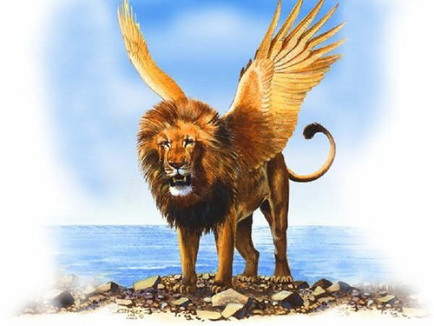
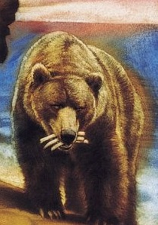
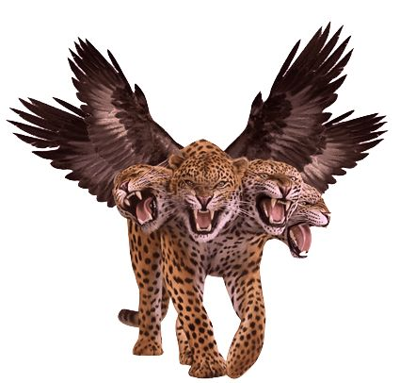
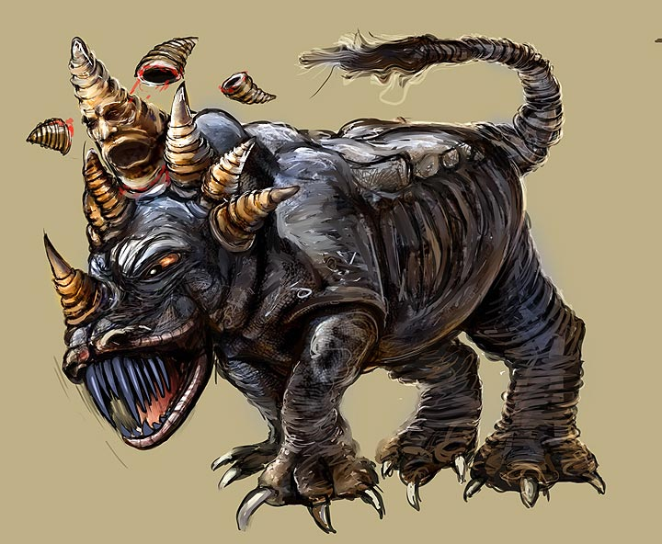

Slide 5
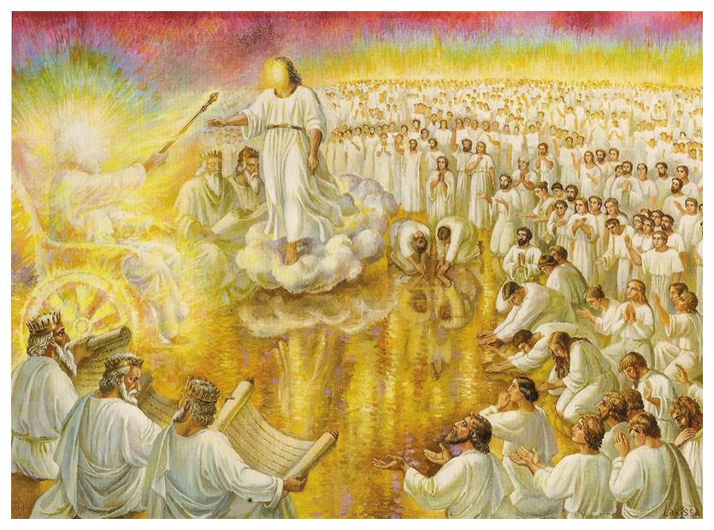

Slide 6
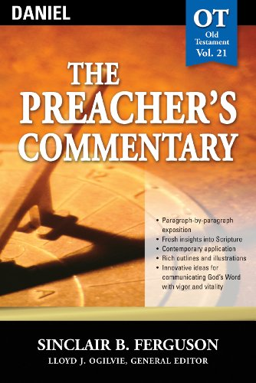
“…the title (Son of man) has particular rather than general significance. This is the True Man in contrast to the man-become-beast in the earlier elements of the vision. This is the one who is able to stand in the presence of God whose throne is made of the fire of his judgement. This is the one who is worthy to receive “dominion and glory and a kingdom that all peoples, nations, and languages should serve Him.” This True Man is all that humans as God’s image were meant to be but failed to be.”

Slide 7
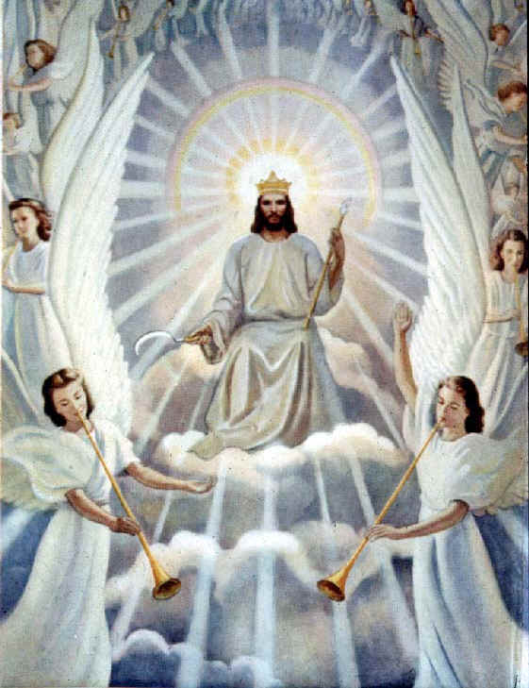
“A vision that began like a nightmare with monsters coming out of the seas, ends happily and hopefully with a Man coming out of the heaven whom God crowns sovereign over the world!”

Slide 8
God and Monsters
God is more powerful than any of the monsters we face.
God reigns over His Kingdom; we will possess the Kingdom forever.
“Therefore, since we are receiving a kingdom that cannot be shaken, let us be thankful, and so worship God acceptably with reverence and awe, for our God is a consuming fire.” Heb. 12:28

